Slide 1


Asp.net Web forms and Controls

Slide 2


Overview
Introduction
ASP.NET Web forms
The Purpose of Web Forms
What is .ASPX File Extension?
Runtime Compilation
Web Forms Syntax
Asp.net page directives
Asp.net Web Controls

Slide 3


Introduction
Microsoft® ASP.NET is the next generation technology for Web application development.
It takes the best from Active Server Pages (ASP) as well as the rich services and features provided by the Common Language Runtime (CLR).
The result is
  A robust
  A scalable
  A fast Web development experience that will give you great flexibility with little coding.

Slide 4
ASP.NET Web forms
ASP.NET Web Forms is a part of the ASP.NET Web application framework.
Web Forms are the heart and soul of ASP.NET.
Web Forms are the User Interface (UI) elements that give your Web applications their look and feel.
Web Forms provide
  Properties
  Methods
  Events for the controls that are placed onto them.
Microsoft Visual Studio® .NET, you will also get the familiar drag-and-drop interface used to create your UI for your Web application.

Slide 5
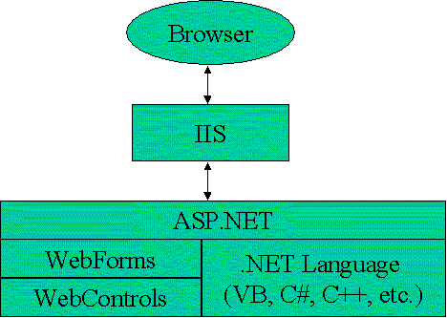
ASP.NET Web forms
Web Forms are made up of two components:
  The visual portion (the ASPX file)(Design portion)
  The code behind the form, which resides in a separate class file.(logic)

Slide 6
ASP.NET Web forms
Web Forms has been a core feature in ASP.NET .
Many enhancements have been in this area for ASP.NET 4,
  The ability to set meta tags.
  More control over view state.
  Easier ways to work with browser capabilities.
  Support for using ASP.NET routing with Web Forms.
  More control over generated IDs.
  The ability to persist selected rows in data controls.
  More control over rendered HTML the FormView and ListView controls.
  Filtering support for data source controls.

Slide 7
The Purpose of Web Forms
To overcome some of the limitations of ASP.
Separation of HTML interface from application logic
A rich set of server-side controls that can detect the browser and send out appropriate markup language such as HTML.
Less code to write.
Event-based programming model.
Compiled code and support for multiple languages.
Allows third parties to create controls that provide additional functionality.
ASP.NET a kind of multi-form interface

Slide 8

What is .ASPX File Extension?
The .aspx (Active Server Page Extended) file extension stores script and source codes that allow web browsers to translate and open web pages.
Is it safe to alter/delete aspx file types?
  No, The reason being is that the .aspx file extension files are one of the core files used by your web browser to render web pages.
  Their absence or incorrect modification may prevent your web browser from functioning correctly.

Slide 9
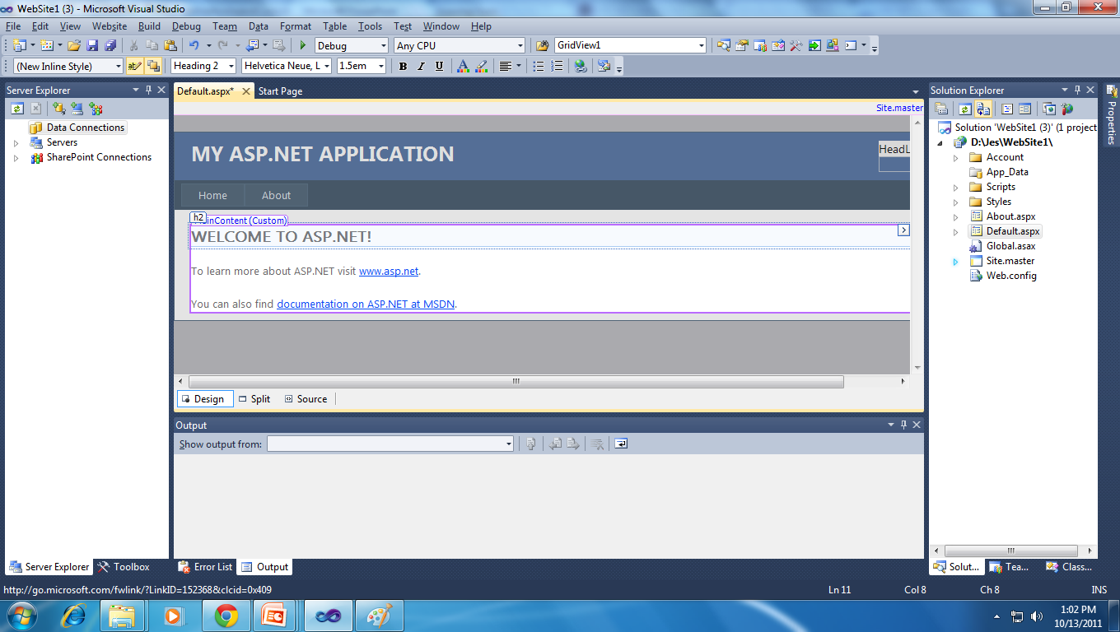
Default.aspx

Slide 10
Runtime Compilation
Code-
behind
class
Parse
ASPX
Engine
Generate
ASPX
File
Gen’d
Page
Class
Request
Instantiate
Request
Compile
Response
Page
Class
Response
Instantiate, Process and Render

Slide 11

Web Forms Syntax
An ASP.NET page is defined as a file in a Web application with an .aspx file name extension with an HTML form element that specifies runat="server".
ASP.NET Web pages are created in a manner similar to static HTML Web pages.
Defines page-specific (.aspx file) attributes used by the ASP.NET page parser and compiler.
<%@ Page attribute="value" [attribute="value"...] %>

Slide 12
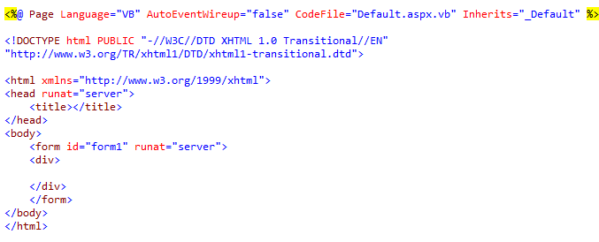
Web Forms Syntax

Slide 13
Asp.net page directives
Allow you to specify page properties and configuration information for the page.
The directives are used as instructions for how to process the page.
Other common directives include the following:
    @ Page :To specify many configuration options for the page
    @ Import : To specify namespaces that you want to reference in your code.
    @ OutputCache :To specify that the page should be cached, along with parameters for when and how long to cache the page.
    @ Implements :To specify that the page implement a .NET interface.
    @ Register: To register additional controls for use on the page.

Slide 14

@Page Directive
Which allows you to specify many configuration options for the page.
Following Sample:
  The server programming language for code in the page.
  Debugging and tracing options.
  Whether the page has an associated master page and should therefore be treated as a content page.
Syntax
  <%@ Page attribute="value" [attribute="value"...] %>

Slide 15
@Page Directive Attributes
Attributes | Description
Buffer | Determines whether HTTP response buffering is enabled. True if page buffering is enabled; otherwise, false. The default is true.
ClassName | Specifies the class name for the page that will be dynamically compiled automatically when the page is requested.
ClientTarget | Indicates the target user agent for which ASP.NET server controls should render content. This value can be any valid user agent or alias.
CodeBehind | Specifies the name of the compiled file that contains the class associated with the page.

Slide 16
@Page Directive Attributes
Attributes | Description
CodePage | Indicates the code page value for the response
CompilerOptions | A string containing compiler options used to compile the page
Culture | Indicates the culture setting for the page.
Debug | Indicates whether the page should be compiled with debug symbols. True if the page should be compiled with debug symbols; otherwise, false..
Description | Provides a text description of the page
LCID | Defines the locale identifier for the Web Forms page.

Slide 17
@Page Directive Attributes
Attributes | Description
EnableSessionState | Defines session-state requirements for the page. True if session state is enabled; ReadOnly if session state can be read but not changed; otherwise, false.
EnableViewState | Indicates whether view state is maintained across page requests.True if view state is maintained; otherwise, false. The default is true.
ErrorPage | Defines a target URL for redirection if an unhandled page exception occurs
Language | Specifies the language used when compiling all inline rendering (<% %> and <%= %>) and code declaration blocks within the page. Values can represent any .NET-supported language, Visual Basic, C#, or JScript .NET.

Slide 18
@Page Directive Attributes
Attributes | Description
Src | Specifies the source file name of the code-behind class to dynamically compile when the page is requested
Strict | Indicates that the page should be compiled using the Visual Basic Option Strict mode. True if Option Strict is enabled; otherwise, false. The default is false.
Trace | Indicates whether tracing is enabled. true if tracing is enabled; otherwise, false. The default is false
WarningLevel | Indicates the compiler warning level at which you want the compiler to abort compilation for the page

Slide 19
@Control Directives
Defines user-control (.ascx file) specific attributes that are used by the ASP.NET page parser and compiler.
Attributes:
  AutoEventWireup
  ClassName
  CompilerOptions
  Debug
  Description
  EnableViewState
  Strict
  Src
  WarningLevel
  Explicit
  Inherits
  Language

Slide 20
@Import Directives
Explicitly imports a namespace into a page, making all classes and interfaces of the imported namespace available to the page.
Syntax:
  <%@ Import namespace="value" %>
Attributes:
  Namespace
    This can include any of the namespaces included in the .NET Framework or a custom namespace.

Slide 21
@Implements Directives
Indicates that the current page or user control implements the specified .NET Framework interface.
Syntax:
<%@ Implements interface="ValidInterfaceName" %>
Attributes
  Interface: The interface to be implemented on the page or user control.

Slide 22
@Register Directives
Associates aliases with namespaces and class names for concise notation in custom server control syntax.
Use the @ Register directive in the following situations.
  To declaratively add a custom ASP.NET server control to a page or user control.
  To add a declarative user control to a page or user control.
Attribute:
  tagprefix
  Tagname
  Namespace
<%@ Register tagprefix="tagprefix" Namespace="namespace" Assembly="assembly" %>
<%@ Register tagprefix="tagprefix" Tagname="tagname" Src="pathname" %>
  Src
  Assembly

Slide 23
Page Event Lifecycle
Web forms are structured using events
Web form can respond to page events
Initialize
Page_Init
Restore Control State
Load Page
Page_Load
Control Events
1. Change Events
Textbox1_Changed
2. Action Events
Button1_Click
Save Control State
Render
Unload Page
Page_Unload

Slide 24
Server Code
ASP.NET pages include code that runs on the server when the page is processed.
Languages including C#, Visual Basic, J#, Jscript, and others.
The Language Support

Slide 25
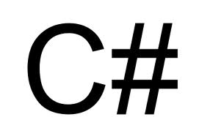
Server Code
ASP.NET pages include code that runs on the server when the page is processed.
The languages including C#, Visual Basic, J#, Jscript, and others.
ASP.NET supports two models for writing server code for a Web page.
  Single-file model:
    The code for the page is in a script element where the opening tag includes there runat="server" attribute
  Code Behind model:
    The code-behind file contains the complete class declarations in the default namespace.

Slide 26
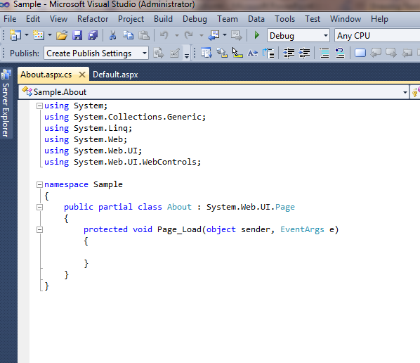
Code Behind pages

Slide 27
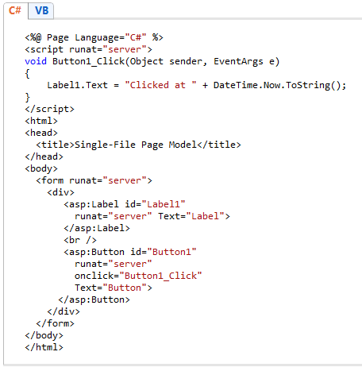
Single-file model

Slide 28
Advantages
Advantages of the single-file page model
  There is not very much code.
  Pages written using the single-file model are slightly easier to deploy
  And to send to another programmer because there is only one file.
  A single-file page is easier to rename if you are using tools other than Visual Studio.
  Managing files in a source code control system is slightly easier.
Advantages of the code-behind model
  Code-behind pages offer a clean separation of the markup (user interface) and code.
  It is practical to have a designer working on the markup while a programmer writes code.
  Code can be reused for multiple pages.

Slide 29
ASP.NET Master Pages
ASP.NET master pages allow to create a consistent layout for the pages in your application.
A single master page defines the look and feel and standard behavior that want for all of the pages in your application.
Then create individual content pages that contain the content you want to display.
When users request the content pages, they merge with the master page to produce output that combines the layout of the master page with the content from the content page.
Master pages actually consist of two pieces, the master page itself and one or more content pages.

Slide 30
ASP.NET Master Pages
A master page is an ASP.NET file with the extension .master
The master page is identified by a special @ Masterdirective that replaces the @ Page directive that is used for ordinary .aspx pages.
The @ Master directive can contain most of the same directives that a @ Control directive can contain.
For example, the following master-page directive includes the name of a code-behind file, and assigns a class name to the master page.

Slide 31
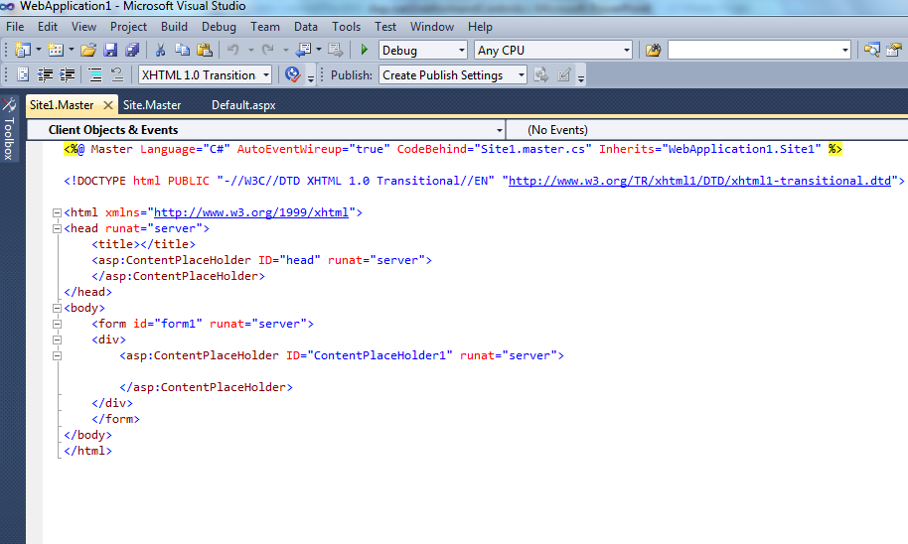
ASP.NET Master Pages

Slide 32
ASP.NET Master Pages
Content Pages
  You define the content for the master page's placeholder controls by creating individual content pages.
  which are ASP.NET pages (.aspx files and, optionally, code-behind files) that are bound to a specific master page.
  In the content page, you create the content by adding Content controls and mapping them to ContentPlaceHoldercontrols on the master page.

Slide 33
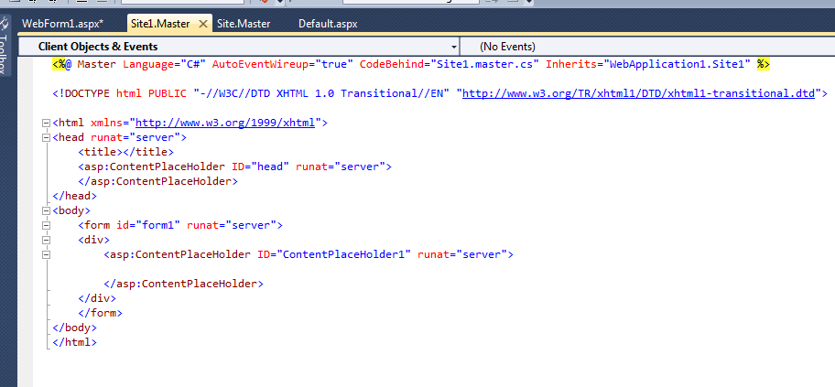
ASP.NET Master Pages

Slide 34
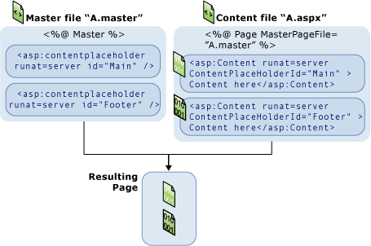
Run-time Behavior of Master Pages
The @ Page directive binds the content page to a specific master page
It defines a title for the page that will be merged into the master page.
Users request a page by typing the URL of the content page.
When the page is fetched, the @ Page directive is read.
The content of individual Content controls is merged into the corresponding ContentPlaceHolder control in the master page

Slide 35
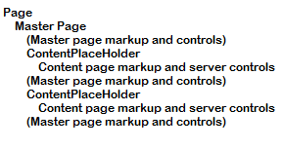
Run-time Behavior of Master Pages
The resulting merged page is rendered to the browser.
The control tree for a merged master and content page looks something like this:
if you set a page-wide property on the master page, it can affect the behavior of the content page, because the master page is the closest parent for the controls on the page.

Slide 36
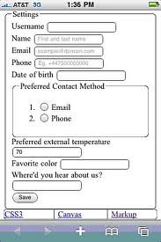
Form Elements
If your page includes controls that allow users to interact with the page and submit it, the page must include a form element.
The rules for using the form element are as follows:
  The page can contain only one form element.
  The form element must contain the runat attribute with the value set to server.
  Server controls that can perform a postback must be inside the form element.
  The opening tag must not contain an action attribute.

Slide 37
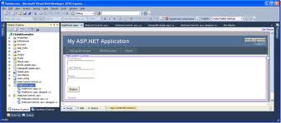
Asp.net Web Controls
ASP.NET pages, you will add controls that allow the user to interact with the page.
Different types of controls that you can use in Web Forms and the ASP.NET Framework.
Organized into logical families
  HTML Controls
  Server Controls
  Navigation controls
  Validation Controls
  Data Controls
The controls you use determine which properties, events, and methods you will get for each control.

Slide 38

HTML Controls
HTML controls are same HTML elements that were using Front Page or any other HTML editor to draw your UI.
if you wanted to create a text box, you would write:
<input type="text" id=txtFirstName size=25>
By Visual Studio .NET, you choose a TextField control from the HTML Toolbox tab and draw the control where you want it on the HTML page.

Slide 39
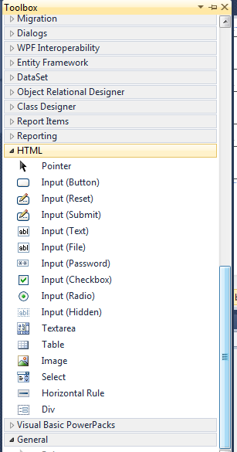
HTML Controls
Derived from System.Web.UI.HtmlControls.
HTML controls available in ASP.NET
Button
Reset Button
Submit Button
Text Field
Text Area
File Field
Password Field
CheckBox
Radio Button
Table
Image
ListBox
Dropdown
Horizontal Rule

Slide 40
HTML controls
It optionally assign an ID attribute to each control, allowing you to write client-side JavaScript code for any of the events that are common for this particular type of control.
Event | Description
OnBlur | Control loses focus
OnChange | Contents of the control are changed
OnClick | Control is clicked on
OnFocus | Control receives focus
OnMouseOver | Mouse moves over this control

Slide 41
Server Controls
Web Form controls are created and run on the Server just like the HTML controls.
They render the appropriate HTML and send that HTML into the output stream.
For example, a DropDownList control will allow you to bind to a data source, yet the output that is rendered is standard<SELECT> and <OPTION> tags when sent to a browser.
All Web Form controls inherit from a common base class:
  The System.Web.UI.WebControls class.

Slide 42
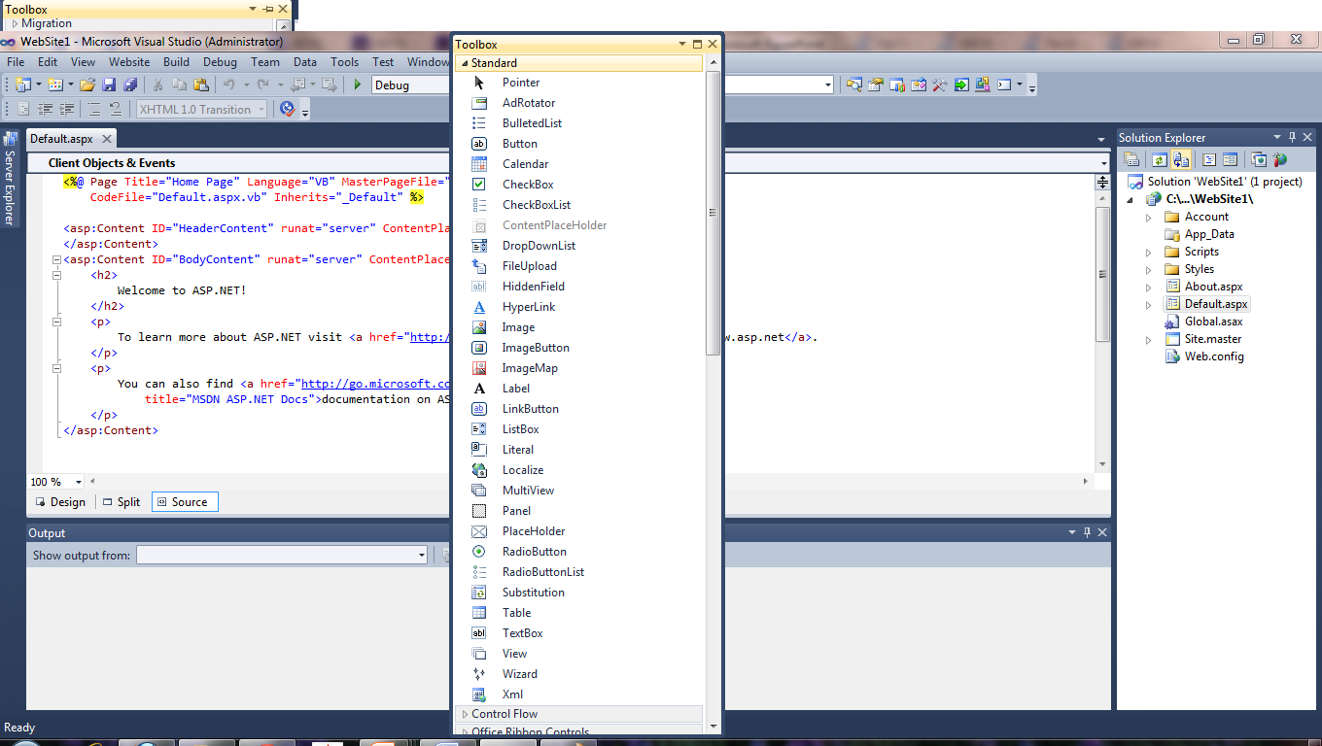
Server Controls

Slide 43


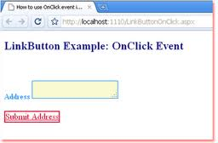
Server Controls
Label: Displays text on the HTML page.
  Commonly Used Server-Side Events of Label is None.
  Web Form Code Example:
  <asp:Label id=Label1 runat="server">Label</asp:Label>
TextBox: Gives the user an input area on an HTML form.
  Commonly Used Server-Side Events of Label is TextChanged.
  Web form code sample:<asp:TextBox id=TextBox1 runat="server"></asp:TextBox>
LinkButton: Like a button in that it posts back to a server, but the button looks like a hyperlink.
    Commonly Used Server-Side Events of Label is Click, Command.
    <asp:LinkButton id=LinkButton1 runat="server">LinkButton</asp:LinkButton>

Slide 44
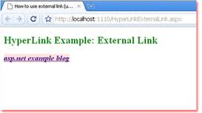
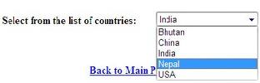
Server Controls
Hyperlink:
  A normal hyperlink control that responds to a click event.
  Commonly Used Server-Side Events is none
  <asp:HyperLink id=HyperLink1 runat="server">HyperLink
  </asp:HyperLink>
DropDownList
  A normal dropdown list control like the HTML control, but can be data bound to a data source.
  Commonly Used Server-Side Events is SelectedIndexChanged.
  Web Form Code Example:<asp:DropDownList id=DropDownList1 runat="server"></asp:DropDownList>

Slide 45

Server Controls
Button:
  A normal button control used to respond to click events on the server.
  You are allowed to pass additional information by setting the CommandName and CommandArguments properties.
  Web Form Code Example:<asp:Button id=Button1 runat="server" Text="Button"></asp:Button>
ImageButton:
  Can display a graphical image, and when clicked, posts back to the server command information such as the mouse coordinates within the image, when clicked.
  Commonly Used Server-Side Events :Click
  Web Form Code Example:- <asp:ImageButton id=ImageButton1 runat="server"></asp:ImageButton>

Slide 46
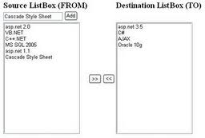

Server Controls
ListBox:
  A normal ListBox control like the HTML control, but can be data bound to a data source
  Commonly Used Server-Side Events is SelectedIndexChanged
  Example Code:<asp:ListBox id=ListBox1 runat="server"></asp:ListBox>
CheckBox:
  Very similar to the normal HTML control that displays a check box for the user to check or uncheck.
  Commonly used Server Side events is CheckChanged
  Example Code: <asp:CheckBox id=CheckBox1 runat="server"></asp:CheckBox>

Slide 47

Server Controls
CheckBoxList:
  Displays a group of check boxes that all work together.
  Commonly used Server side event:SelectedIndexChanged
  Example Code:<asp:CheckBoxList id=CheckBoxList1 runat="server"></asp:CheckBoxList>
RadioButton:
  Very similar to the normal HTML control that displays a button for the user to check or uncheck.
  Commonly used Server side Event:CheckChanged
  Example Code: <asp:RadioButton id=RadioButton1 runat="server"></asp:RadioButton>

Slide 48

Server Controls
RadioButtonList
  Displays a group of radio button controls that all work together
  Commonly used Server side event:SelectedIndexChanged
  Code example:<asp:RadioButtonList id=RadioButtonList1 runat="server"></asp:RadioButtonList>
Image
  Very similar to the normal HTML control that displays an image within the page.
  No Server Side event.
  Example code:<asp:Image id=Image1 runat="server"></asp:Image>
Panel
  Used to group other controls
  No Server side events Supported
  Example Code:<asp:Panel id=Panel1 runat="server">Panel</asp:Panel>

Slide 49
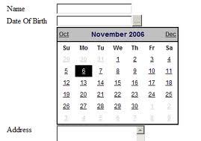
Server Controls
PlaceHolder:
  Acts as a location where you can dynamically add other server-side controls at run time.
  Commonly used Server side event None
  Code Sample:<asp:PlaceHolder id="PlaceHolder1" runat="server"></asp:PlaceHolder>
Calendar:
  Creates an HTML version of a calendar. You can set the default date, move forward and backward through the calendar, etc.
  Commonly used Server side Events:SelectionChanged, VisibleMonthChanged, DayRender
  Code Sample:<asp:Calendar id=Calendar1 runat="server"></asp:Calendar>

Slide 50
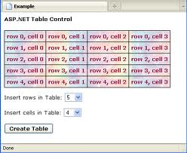
Server Controls
AdRotator:
  Allows you to specify a list of ads to display. Each time the user re-displays the page, the display rotates through the series of ads.
  Commonly used Server side event: AdCreated
  Example code: <asp:AdRotator id=AdRotator1 runat="server"></asp:AdRotator>
Table
  Very similar to the normal HTML control
  Commonly Used Server side event is None
  Example code: <asp:Table id=Table1 runat="server"></asp:Table>

Slide 51
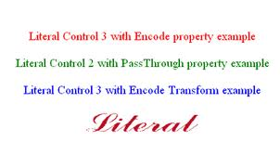
Server Controls
XML
  Used to display XML documents within the HTML, It can also be used to perform an XSLT transform prior to displaying the XML
  Commonly used Server side events: None
  Example code: <asp:Xml id="Xml1" runat="server"></asp:Xml>
Literal
  Like a label in that it displays a literal, but allows you to create new literals at runtime and place them into this control.
  <asp:Literal id="Literal1" runat="server"></asp:Literal>

Slide 52
Validation Controls
Web Form control validates data on the client browser, before the user submits the data to the back-end server.
  RequiredFieldValidator: Ensures that a value is entered
  RangeValidator: Checks if value is within minimum and maximum values
  CompareValidator:Compares value against constant, another control or data type
  RegularExpressionValidator: Tests if value matches a predefined pattern
  CustomValidator:Lets you create custom client- or server-side validation function.
  ValidationSummary:Displays list of validation errors in one place

Slide 53
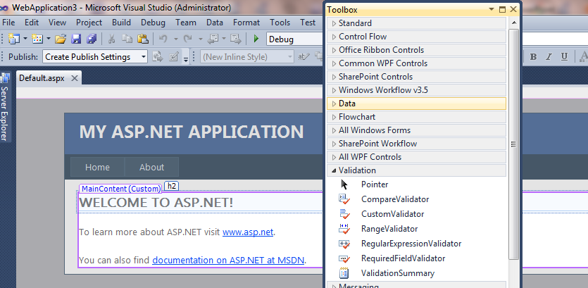
Validation Controls
Validation controls contain Error messgae which is displayed only if validation fails
Validation controls are associated with their target control using the ControlToValidate property

Slide 54
Navigation controls
ASP.NET has three new navigation controls:
  Menus:
    The Menu control supports a main menu and submenus, and allows you to define dynamic menus (sometimes called "fly-out" menus).
  TreeViews:
    The TreeView control is used to display hierarchical data, such as a table of contents or file directory, in a tree structure.
  Site Map Path:
    The SiteMapPath control displays a navigation path (which is also known as a breadcrumb or eyebrow) that shows the user the current page location and displays links as a path back to the home page.

Slide 55
Data Controls
There are two types of ASP.NET data controls available in Microsoft Expression Web:
Data Source controls:
  which allow you to set properties for connections to database or XML data sources
    AccessDataSource
    SiteMapDataSource
Data controls:
  which allow you to display data from data sources specified in Data Source controls.
    DataList
    DetailsView
    FormView
    GridView
    SqlDataSource
    XmlDataSource
Repeater

Slide 56
Summary
Using HTML pages, ASPX (Web Form) pages, HTML controls, and Web Form controls,
Now have a fantastic RAD environment for creating very robust, scalable, and flexible Web applications in ASP.NET.
Should find that the move to ASP.NET is easier than moving from Visual Basic 2010 to ASP development as you now have the same development environment and the same programming model.

Slide 57


Slide 58


Reference Link
http://msdn.microsoft.com/en-us/library/ms973868.aspx
http://msdn.microsoft.com/en-us/library/xz702w3e.aspx
http://msdn.microsoft.com/enus/library/cc295544(v=expression.30).aspx
http://msdn.microsoft.com/enus/library/cc295567(v=expression.30).aspx
http://msdn.microsoft.com/enus/library/cc295349(v=expression.30).aspx
http://msdn.microsoft.com/enus/magazine/cc302014.aspx

